Slide 1
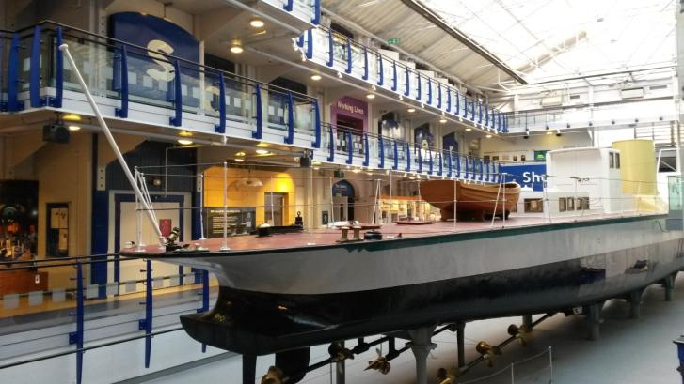
A Visual Guide to Discovery Museum

Slide 2
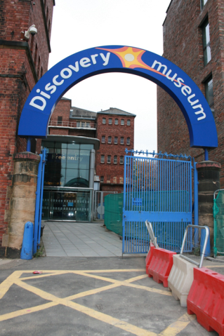
The outside of the Discovery Museum looks like this. The entrance is signposted and round the right of the glass front.

Slide 3
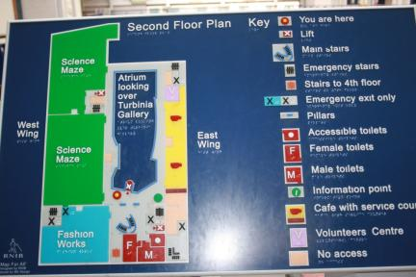
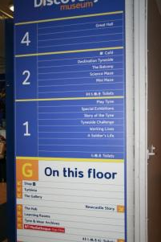
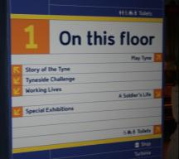
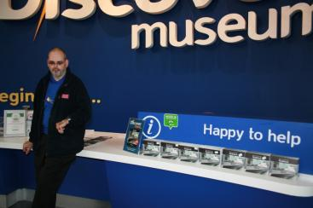
Navigating your way around the museum
There are lots of maps and signs to help you find what you are looking for on each floor.
If you are still lost there are plenty of people to ask. They look like this.

Slide 4
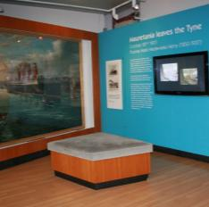
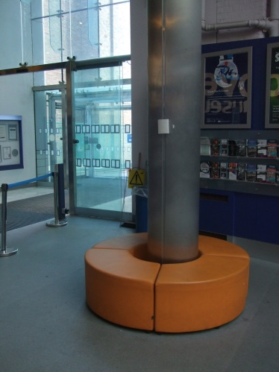
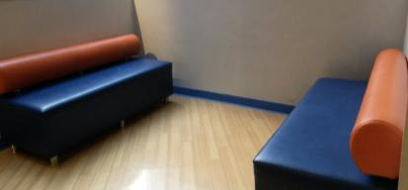
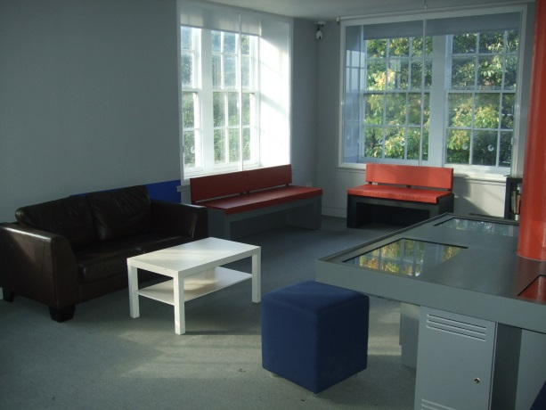
Places to relax……..
There are plenty of seats around the museum in quieter areas inside and outside the exhibitions on all floors.
Ground floor
First floor
Second floor

Slide 5
Ground Floor

Slide 6
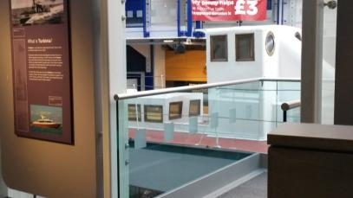
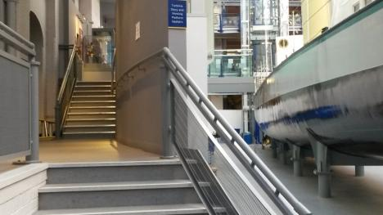
The Turbinia
Unfortunately you cannot go on Turbinia but there is a viewing platform. If you need a buggy park there is one to the left of Turbinia.
Buggy park

Slide 7
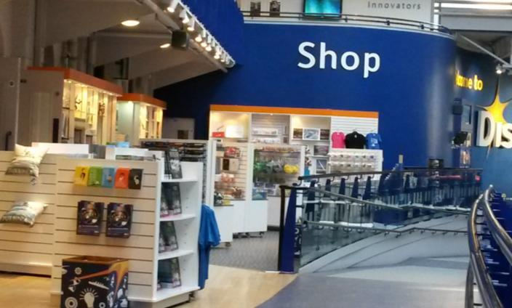
The Shop
As you walk up the ramp from the entrance you will pass the shop selling a range of fun objects from science kits to ships, posters to pencils!

Slide 8
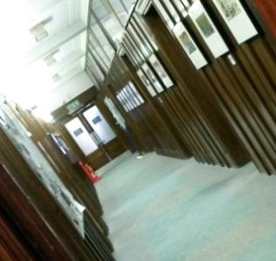
The Archives
Based in Discovery Museum Tyne & Wear Archives is home to thousands of documents relating to the five local districts of Newcastle, Sunderland, Gateshead, North Tyneside and South Tyneside.
There is a great quiet area with art deco stained glass to sit and relax.

Slide 9
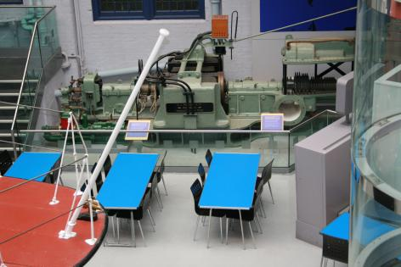
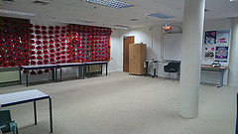
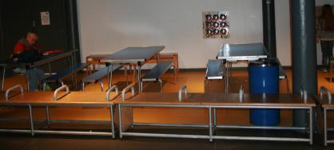
Our Learning Spaces
This is the room where we do workshops with school groups and can be booked out by visitors for birthday parties.
There are two picnic areas to use in the museum if you want to bring a packed lunch. One in Science Maze and one at Turbinia

Slide 10
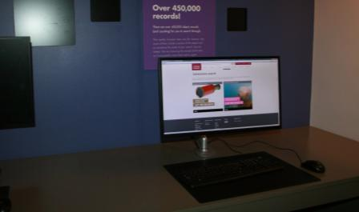
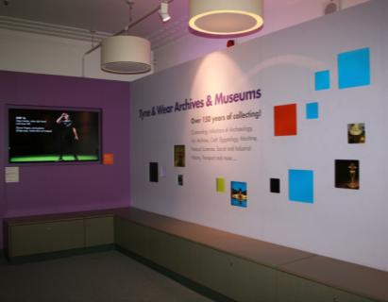
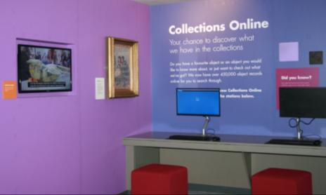
The Hub
A multimedia space that celebrates our collections and how they have been used by communities across the north east. You can even try searching for an object yourself!

Slide 11
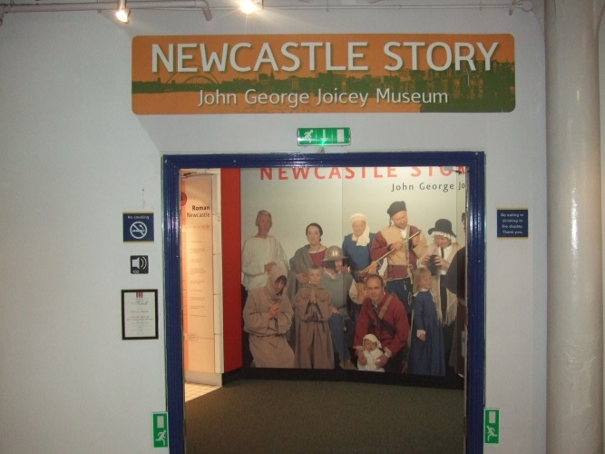
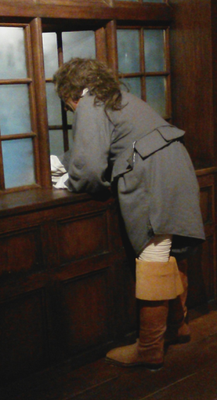
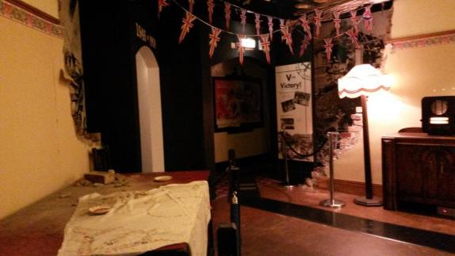
Newcastle Story
Walk the streets of Newcastle through the years, from Roman times to the year 2000.
There are many different familiar and unusual sounds in this exhibition from talking to music. It can be quite loud in places so may not be suitable for all visitors.
A siren goes off in the 1940s house bombed during an air raid.
Watch out for the man shouting out the window.

Slide 12
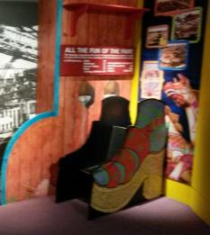
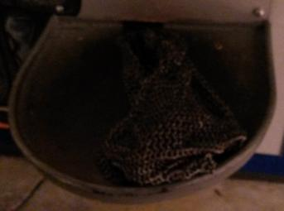
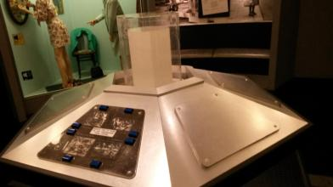
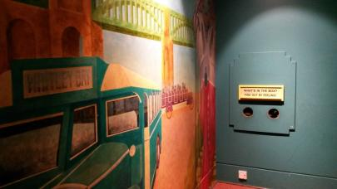
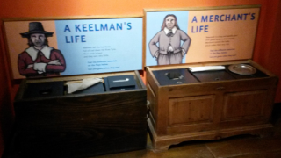
Newcastle Story
These are just some of the things that you can touch and explore.

Slide 13
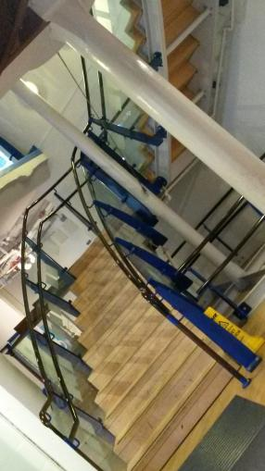
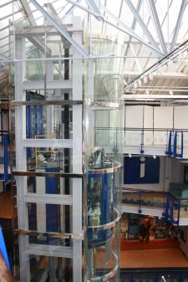
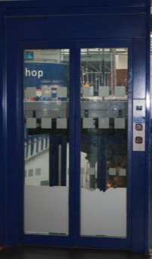
You can take the stairs or catch the lift to first and second floor

Slide 14
First floor

Slide 15
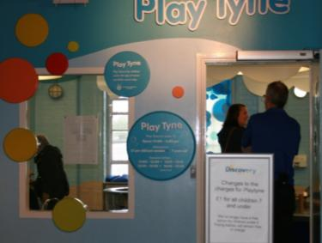
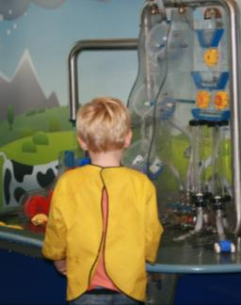
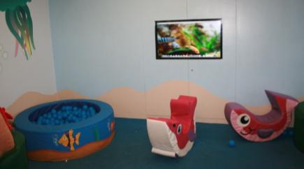
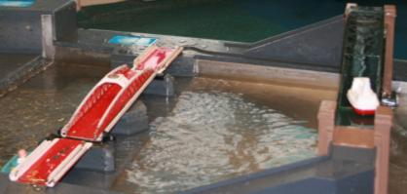
Play Tyne
A multi sensory water play area for Under 7s
For children under 7 there is a charge, please check our website for costs. Babies and adults are free of charge.

Slide 16
A Soldier’s Life Over 200 years of life in the army
This gallery is closed from November so that we can have a new exhibition created and installed. Keep a look out for that opening in Summer 2017.

Slide 17
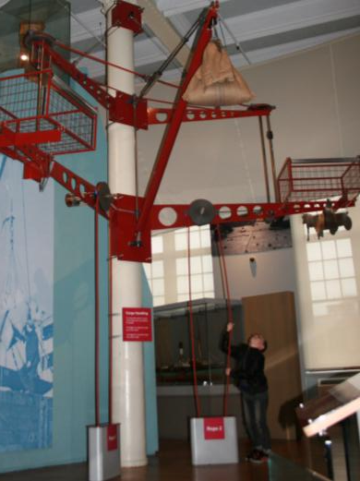
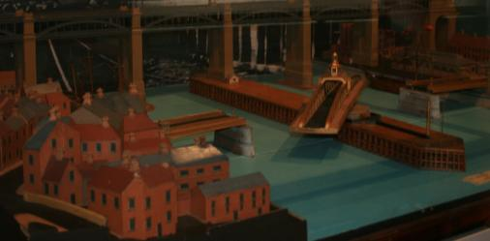
Story of the Tyne
This gallery highlights some of the key industries that scatter the shores of the Tyne, including full size boats, a ship model wall, a model of the river as it flows from its source. There is lots to see and do!
Interactives include a swing bridge and a pully.

Slide 18
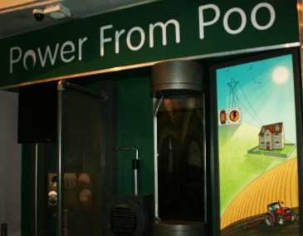
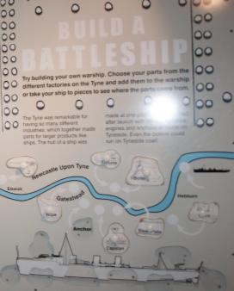
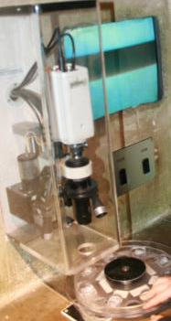
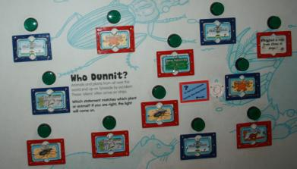
Story of the Tyne
These are just some of the things to touch and explore in Story of the Tyne.

Slide 19
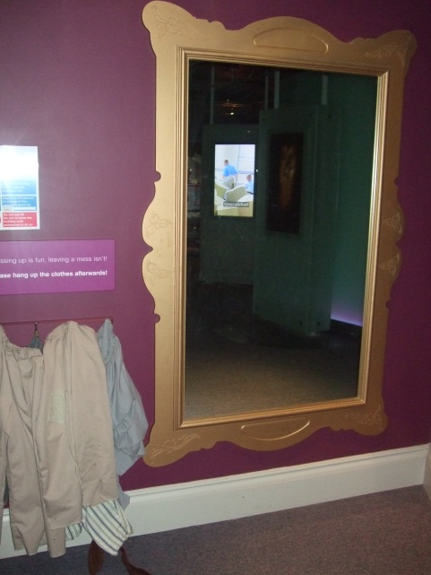
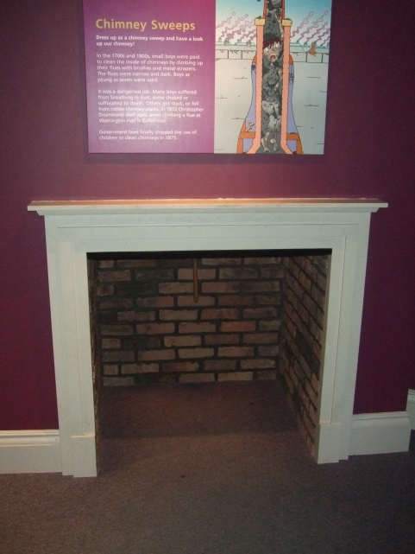
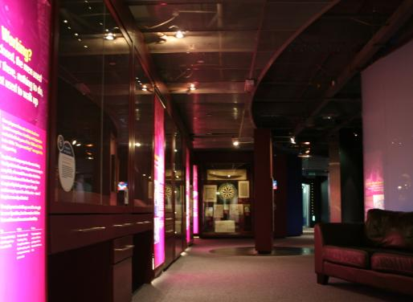
Working Lives
Learn about the experiences of people working and living on Tyneside.
The lighting is dim. There are lots of video.
Experience the life of a chimney sweep. Dress up and climb up the chimney!

Slide 20
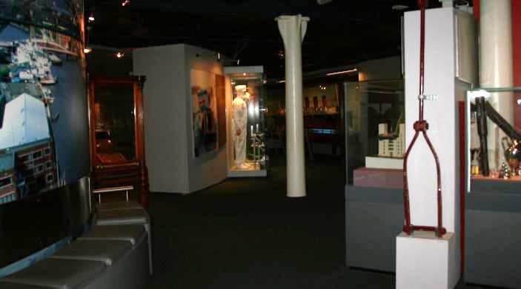
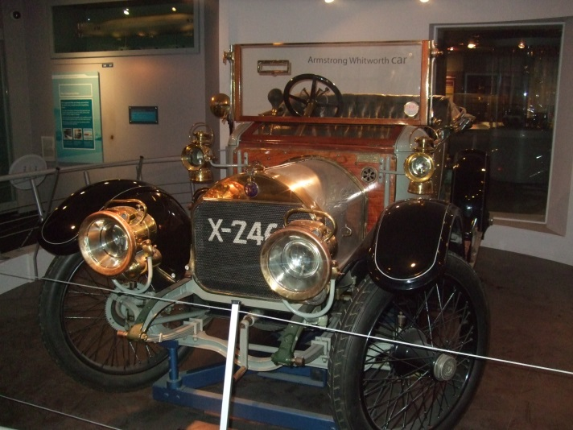
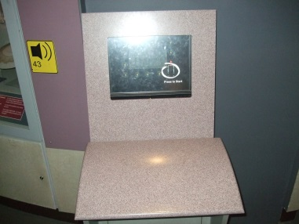
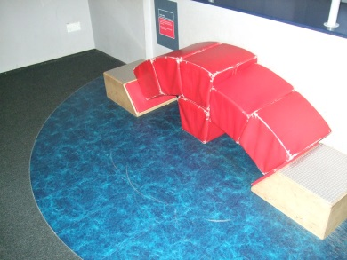
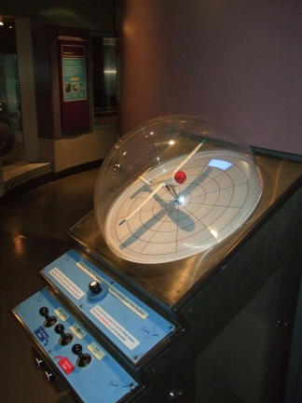
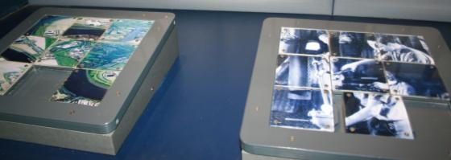
Tyneside Challenge
See some of the most important and interesting inventions made on Tyneside, from Stephenson's famous locomotives to the revolutionary Armstrong No.1 Gun.
This gallery is quite dim.
There are lots of hands on activities.

Slide 21
Second Floor

Slide 22
Café
A selection of hot and cold drinks, meals, sandwiches and cakes are available.
There is a range of seating from Sofas, tub chairs and high chairs for our younger visitors.

Slide 23
Destination Tyneside
Destination Tyneside tells the story of people who have migrated to the North East and who have made Tyneside their home.
This exhibition combines moving image with games and activities. You can even research the lives of some of the migrants to Tyneside, using online websites .

Slide 24
Science Maze
A noisy, interactive space exploring sound, light, forces and electricity.
A huge variety of interactive displays bring science and engineering to life, with favourites including the shadow wall and the air hockey table.
Under 5s play area.
A guide at the entrance helps you to navigate.

Slide 25
More Science Maze interactives
There are lots of hands on activities.

Slide 26
See you soon…..
More information available from
https://discoverymuseum.org.uk/visit-us/access-information
https://discoverymuseum.org.uk/visit-us
https://discoverymuseum.org.uk/learning/essential-information
If you have any questions or require any further information before you visit the museum then please get in touch with a member of the learning team via email learning@discoverymuseum.org.uk or ring 0191 277 2181
Visit https://www.google.com/culturalinstitute/collection/discovery-museum for Street View access to the Museum.

